Slide 1
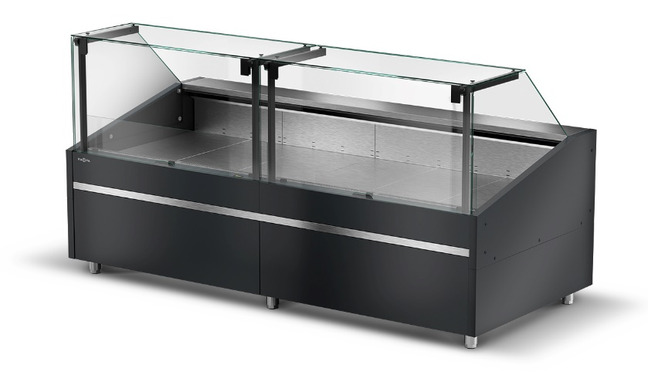
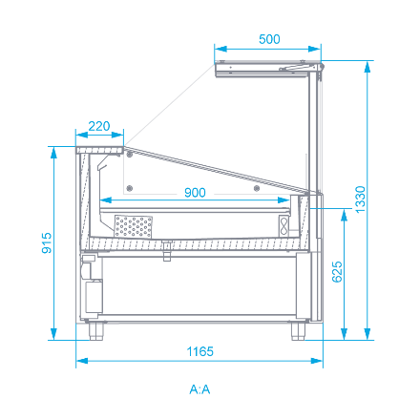
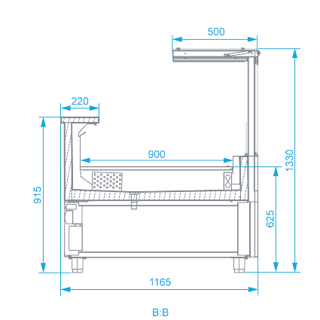
Refrigerated counter L-GT
Selected device finish
 | Upper and lower front – RAL 7016 Anthracite grey - semi-mat Housing – RAL 7016 Anthracite grey - semi-mat Front finish strip – Stainless steel
Refrigerating unit
Remote version (without aggregate)
3rd climatic class
Fan assisted cooling
Electronic temperature controller with display from the service side
Tool-free access to the condenser (plug-in)
Condensate drainage to sewerage system
Housing
Sides painted in colours from the RAPA colour chart, insulated with environmentally friendly polyurethane foam
Upper and lower front painted of the colours chosen from the RAPA colour chart
Housing painted in Anthracite grey colour semi mat RAL 7016
Forklift accessible construction
Front finish strip painted of the colours from the RAPA colour chart or stainless steel
Stainless steel adjustable legs
Double electric socket from the service side in the middle of the device length Worktop
Worktop made of grinded stainless steel of the width of 22 cm Exposition
Divided bottom of the exposition made of grinded stainless steel (pulled out segments)zlif”
Electronic thermometer on the customer side
Adjustable exposure bottom - tilt or lower the exposure bottom without tools
Glass panes opening system on the lift-up cylinders
Front glass pane divided, flat, opened up
Night cover
All panes made of tempered glass
temperatures range | 3M1 (0°C ÷ +5°C) 3M2 (+2°C ÷ +7°C) 3H1 (+6°C ÷ +10°C)
rated voltage | 230 V~ / 50 Hz
rated power | 9 W
defrosting | automatic
model | couter GT | module GT
length | 259 cm | 250 cm
exposition length | 247, 5 cm | 250 cm
depth | 116, 5 cm | 116, 5 cm
exposition depth | 90 cm | 90 cm
height | 133 cm | 133 cm
exposition height | 21 cm | 21cm
Freestanding model
Module designed to be joined in series lines
"RAPA" S. Międlar, W. i I. Szymańscy sp. j. +48 81 718 46 51 TIN PL 7121931385, KRS No. 0000005827, Lublin – East District 9, Ceramiczna Street rapa@rapa.lublin.pl Court in Lublin with seat in Swidnik, VI Economic Department, 20-149 Lublin, POLAND www.rapa.pl/en REGON No. 430833425, BDO No. 000009031

